Slide 1
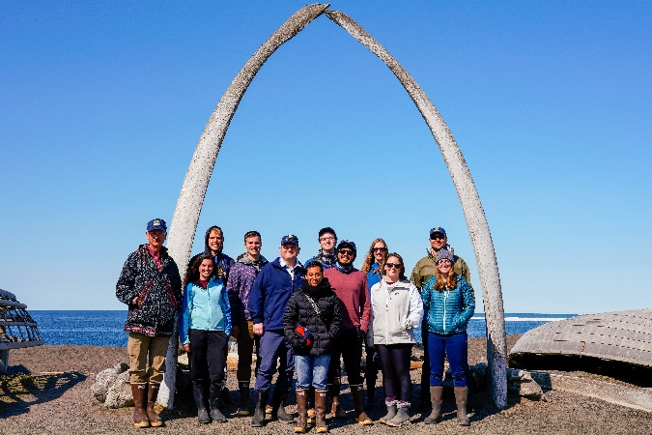
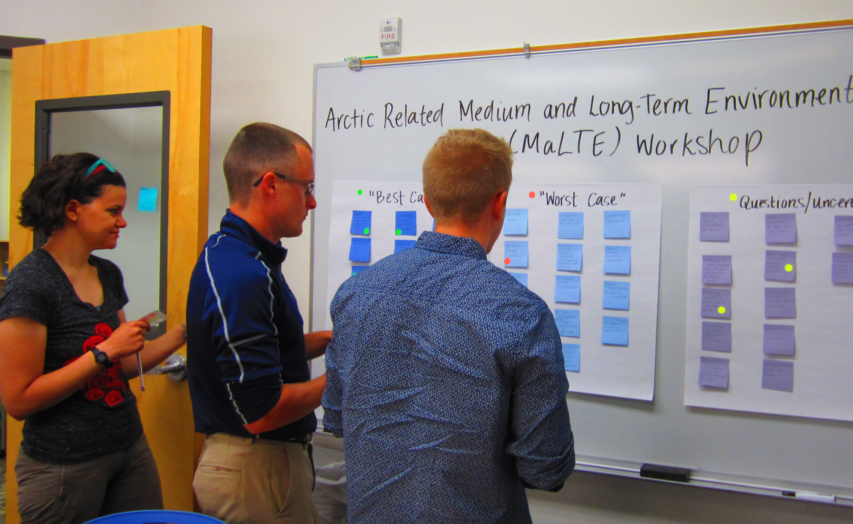
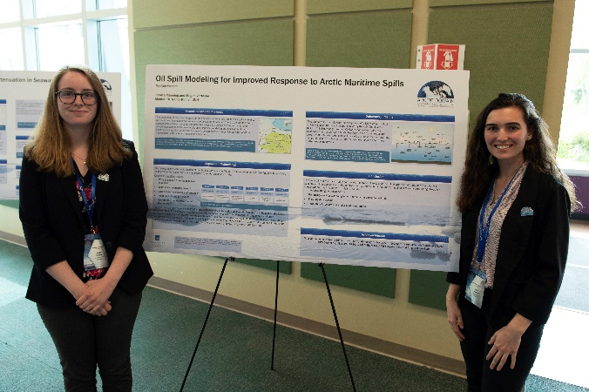
ADAC Year 8 Annual Meeting
...Via Conference Call, 20-21 April 2022
ADAC Project Briefing
ADAC’s Education Program: Workforce Development
Heather Paulsen, ADAC Finance Director
Kevin Fitzpatrick, ADAC Fellow

Slide 2
ADAC Education Program: Structure
ADAC Program Year 8 Annual Meeting
ADAC Fellowship Program
Workforce Development (WFD) Fellowship Program
Integrated Minority Serving Institute (MSI)/Arctic Summer Internship Program (ASIP)
The ADAC Education Program is comprised of two major components:

Slide 3
ADAC’s Workforce Development (WFD) Fellowship Program
ADAC Program Year 8 Annual Meeting

Slide 4
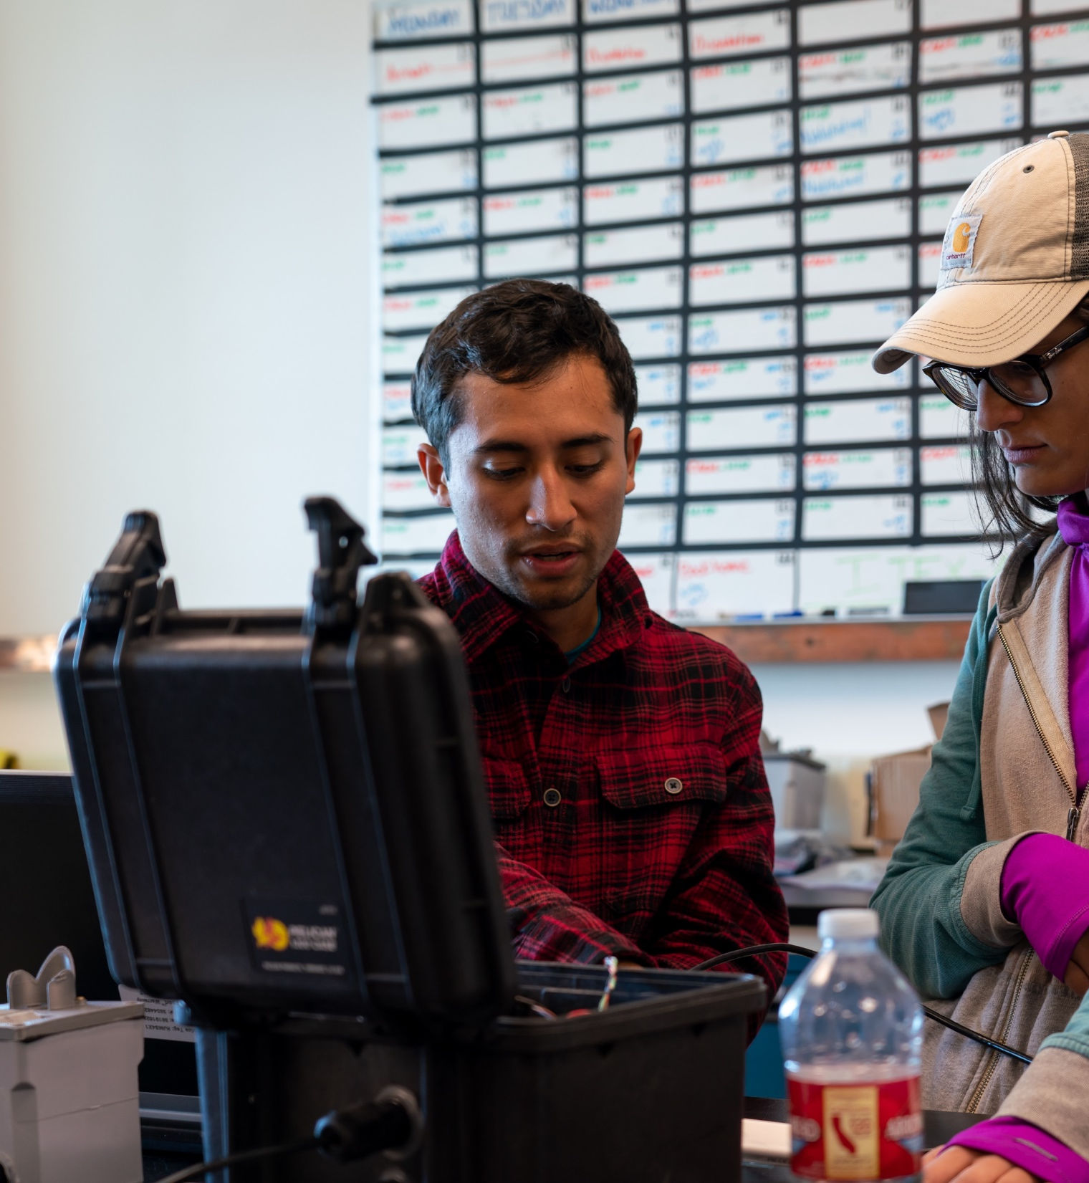
ADAC’s Workforce Development (WFD) Fellowship Program
ADAC Program Year 8 Annual Meeting
Project Principal Investigator: Jeffrey Libby, Executive Director
Lead Institution: University of Alaska Anchorage (UAA)(SME)
Supporting Institutions:
  The University of Texas El Paso (MSI)
  The University of Alaska Fairbanks (SME)
  The University of New Hampshire
  The University of New Orleans
Supporting Team: Dr. Doug Causey, Kori Orion

Slide 5
Workforce Development (WFD) Fellowship Program
ADAC Program Year 8 Annual Meeting
ADAC’s WFD Fellows are funded via a DHS S&T OUP Cooperative Grant
Project Objectives:
Attract the highest caliber undergraduate and graduate students to our education programs.
Nurture and train these students for careers in DHS — related applied fields of science and technology.
Provide students opportunities for direct involvement in DHS operations and embedded research among our DHS collaborators and stakeholders.
Provide education and mentorship to students that leads to timely completion of degrees and fulfilling careers in DHS Enterprise or related fields.
Potential Impact:
Contribute to the growth of highly skilled workforce for Homeland Security agencies.
Contribute to the capability of US Coast Guard operator and in support of USCG missions in the Arctic.
MSI/ASIP Program
Workforce Development(WFD)
Fellowship Program
ADAC Education Program

Slide 6
ADAC Education Program: Eligibility, Commitment, & Support
ADAC Program Year 8 Annual Meeting
ADAC Education Program is open to undergraduate, graduate and advanced graduate students. The following apply to all fellows and interns:
Eligibility requirements:
◦ U.S. citizenship
◦ STEM major
◦ Clear background check
◦ Achieve & maintain a cumulative GPA of 3.30
Commitment:
◦ Complete two 10-week summer internships while in the program.
◦ Actively seek and obtain employment in the Homeland Security Enterprise or a related field for at least one year after graduation.
Note: Employment can be at the state, federal or local level. Undergraduate Fellows can also defer employment to attend graduate school.
Support:
◦ Monthly stipend and tuition support (fall & spring semesters only) at defined levels for undergraduate & graduate students.
◦ Assistance in securing a 10-week internship for two summers.
◦ Mentoring and professional development through ADAC network.

Slide 7
Program Year 8 WFD Fellowship Milestones & Metrics
ADAC Program Year 8 Annual Meeting
Milestones
Performance Metrics
Outreach & Exchange
  Participate in professional exchanges and outreach activities, this includes workshops (Arctic IoNS, MaLTE, local or national research symposiums), and Center meetings with DHS constituents.
Center Activities
  Attend monthly meetings with Center Leadership.
  In collaboration with Project PI’s and ADAC Education & Administrative Manager, develop individual student work plans for their corresponding projects.
Summer Internships
  Participate in one 10-week summer internship (two/summer during Fellowship).
GPA meets DHS requirements (3.30 on 4.0 scale).
Track progress of graduated ADAC Fellows who successfully enter the DHS Enterprise workforce, or related disciplines
Completion two 10-week summer internships for all ADAC fellows who participate in the full duration of the fellowship program.
Graduated Fellows have one year to secure employment in the Homeland Security Enterprise or related disciplines (federal/state/local gov. etc.).

Slide 8
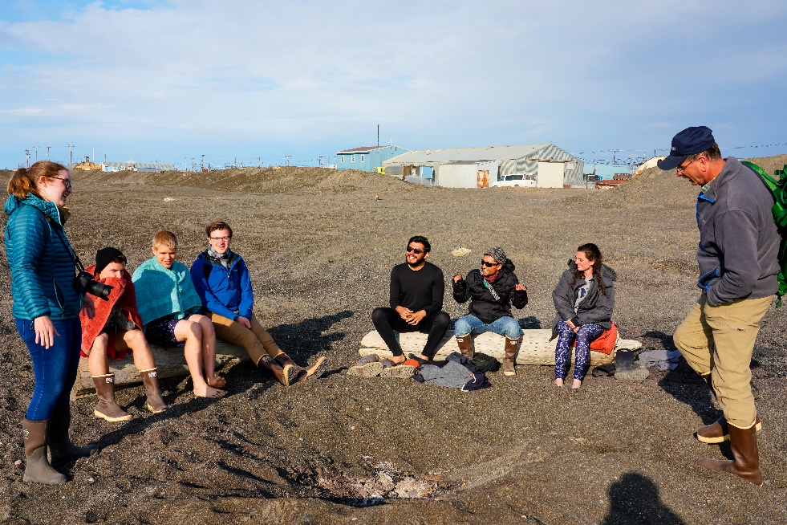
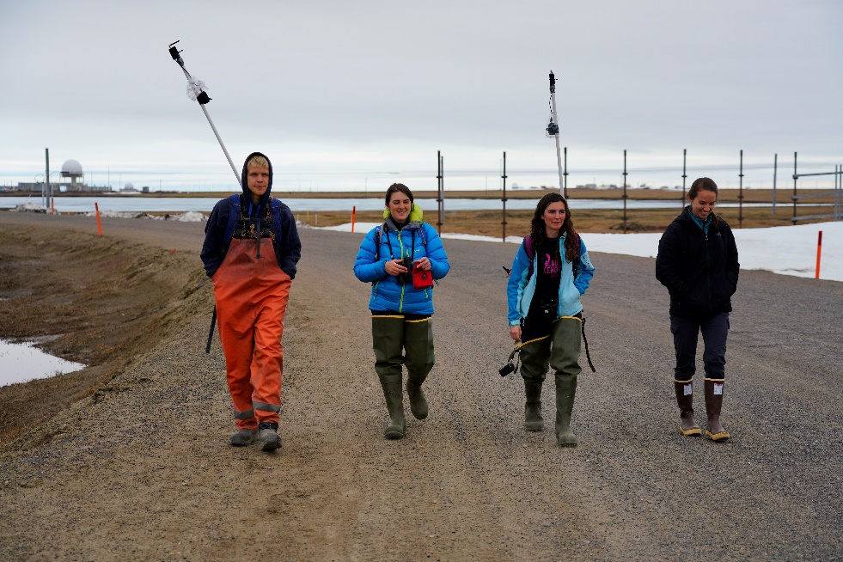
Overall ADAC Fellows in Program Year 8
ADAC Program Year 8 Annual Meeting
Arctic Domain Awareness Center - Program Year 8 Overview of all Supported Fellows
 | Univ. of Alaska Alaska (UAA & UAF) | Univ. of Texas at El Paso, TX (UTEP)* | Univ. of New Hampshire, NH (UNH) | Univ. of New Orleans, LA (UNO)
Undergraduate | 3 | 1 | 1 | 0
Graduate | 0 | 0 |  | 1
Total | 3 | 1 | 1 | 1
Total Overall Active Fellows: | 6
* An accredited MSI institution

Slide 9
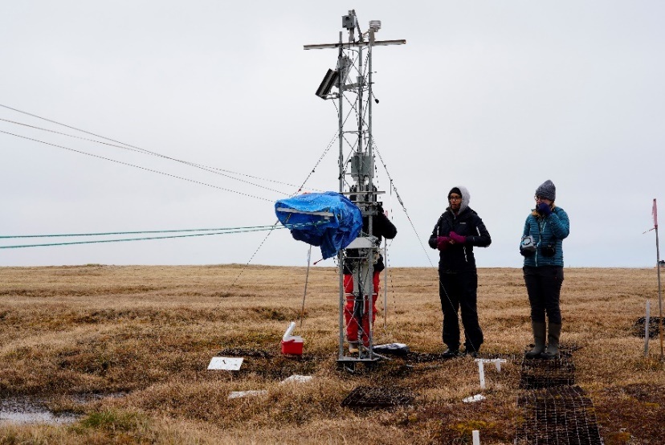
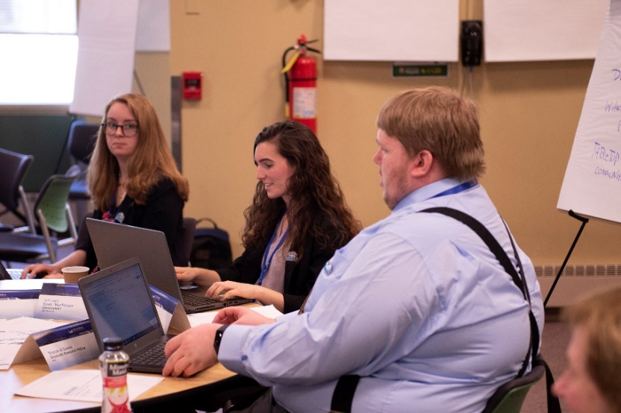
Progress: Outreach, Exchange, & Activities
ADAC Program Year 8 Annual Meeting
Student Exchange Activities:
    November 2021: Maritime Risk Symposium
    January 2022: Alaska Marine Science Symposium
Center-Specific Projects & Activities:
    Summer 2021: ADAC’s Virtual Fellowship Onboarding Program
    September 2021: ADAC’s ERI Project Conference
    Arctic and Alaska Maritime Communications & Connectivity Assessment Literature Review
    Attendance at monthly mentoring meetings with ADAC Leadership Team
    Attendance at weekly All-Hands Meetings with ADAC’s Research Network

Slide 10
Student Research Engagement in ADAC Projects
ADAC Program Year 8 Annual Meeting
Project Name | Fellow(s) on Project | University
Arctic Vessel Monitoring/Geofencing: | Undergraduate Fellows Benjamin Good and Talha Ali | UAA
Arctic Oil Spill Modeling Strategies | Undergraduate Fellow, Tori Sweet | UNH
Arctic Mussels | Graduate Fellow, Katherine Humpal | UNO
Environmental Risk Index | Undergraduate Fellows, Caitlynn Hanna and Brenda Almanza | UAF, UTEP

Slide 11
Next Steps for our Program Year 8 Graduating Fellows
ADAC Program Year 8 Annual Meeting
Student | University | Degree | Where are they headed?
Talha Ali | UAA | B.S. Computer Science | To continue pursuing his undergraduate degree, with an estimated graduation of Spring 2023.
Benjamin Good | UAA | B.S. Computer Science | To continue pursuing his undergraduate degree, with an estimated graduation of Spring 2023.
Caitlynn Hanna | UAF | B.S. Civil Engineering | To pursue a graduate degree at UAF in Civil Engineering.
Brenda Almanza | UTEP | B.S. Environmental Science | To pursue a graduate degree in Environmental Science at UTEP.
Tori Sweet | UNH | B.S. Environmental Engineering | To pursue a graduate degree in Environmental Engineering at UNH.
Katherine Humpal | UNO | Ph.D. Biochemistry | To continue pursuing her graduate degree, with an estimated graduation of spring 2023.

Slide 12
ADAC Fellow Kevin Fitzpatrick
ADAC Program Year 8 Annual Meeting

Slide 13

Working with ADAC
ADAC Program Year 8 Annual Meeting
Introduced by Dr. Patrick Tomco
Worked closely with Dr. Tomco and Dr. McGill on design and execution of arctic mussels project
Participated in 2020 ASIP
Employed with Applied Environmental Research Center (AERC) since May 2021
Transitioning to position with Department of Natural Resources
Graduate with Masters May 1st 2022

Slide 14

Arctic Mussels Project
ADAC Program Year 8 Annual Meeting
Objective: Determine effects of sunlight on treated oil
Report results to spill responders
  i.e. Coast Guard
Spilled marine oil known to photo-enhance
Spill response techniques (Corexit 9500 and in situ burning) may vary in efficacy due to photo-enhancement
Arctic photoperiods comparatively extreme to rest of world

Slide 15
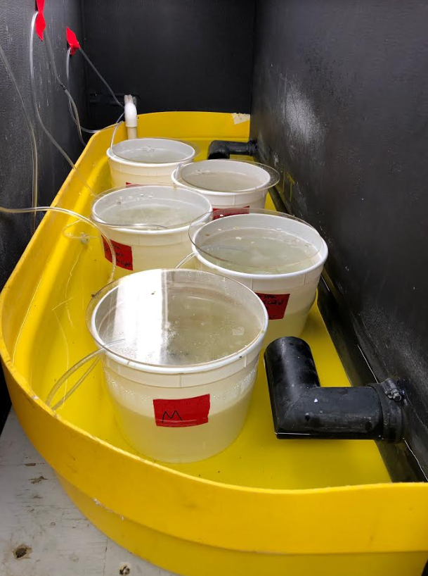
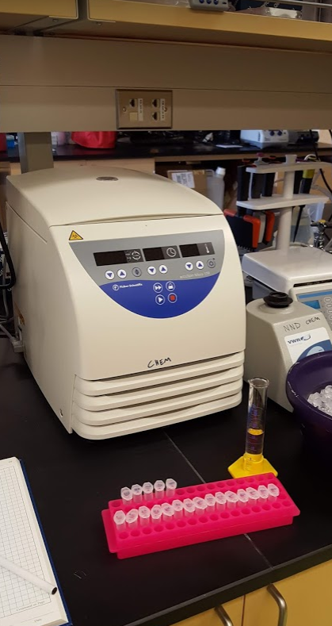
Arctic Mussels Project
ADAC Program Year 8 Annual Meeting
Mytilus trossulus selected as study species
  Collected from beach
  acclimated then exposed
  Gill tissue tested for biochemical stress
Findings recorded and reported
12 hour photoperiod
  highest and most variable response

Slide 16

Opportunities through ADAC
ADAC Program Year 8 Annual Meeting
ADAC Fellowship facilitated my project and graduate degree
  Frequent, supportive meetings
  Networking with colleges and experts
  Career goals and advancement
ASIP – Outreach and Exchange
  Forum for sharing
  Develop and enhance skills
  Interface with varied perspectives

Slide 17
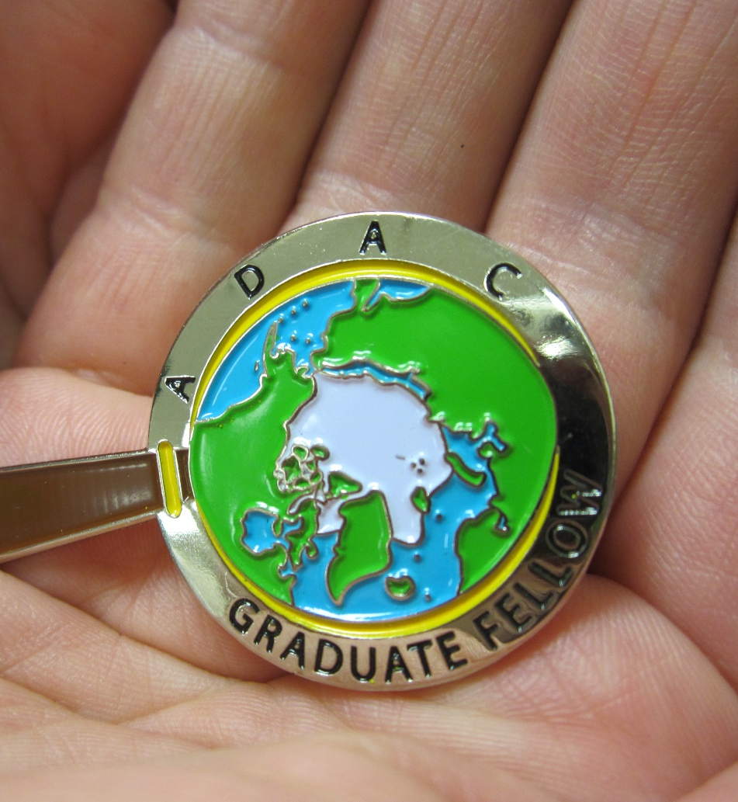
Thank you.
Ready for questions…
ADAC Program Year 8 Annual Meeting
Feedback?
What are we missing?
What can we improve?
Who should we connect with to improve our success?
Notes:
Thank you for the gift of your time and attention.

Slide 18
ADAC Year 8 Annual Meeting
...Via Conference Call, 20-21 April 2022
ADAC Project Briefing
ADAC’s Education Program: Integrated Minority Serving Institute (MSI)/Arctic Summer Internship Program (ASIP)
Douglas Causey, PhD, University of Alaska Anchorage
Craig Tweedie, PhD, University of Texas El-Paso

Slide 19
Integrated Minority Serving Institute (MSI)/Arctic Summer Internship Program (ASIP)
ADAC Program Year 8 Annual Meeting

Slide 20
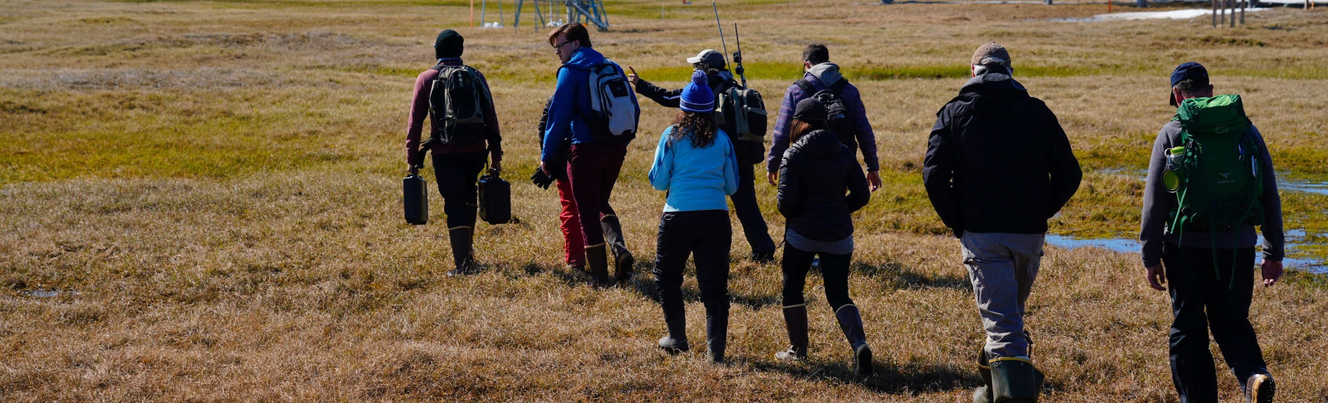
ADAC’s Integrated Minority Serving Institute (MSI)/Arctic Summer Internship Program (ASIP)
ADAC Program Year 8 Annual Meeting
Project Principal Investigators: Douglas Causey (UAA) and Craig Tweedie (UTEP)
Lead Institution: University of Alaska Anchorage (UAA)
Supporting Institution: University of Texas El Paso (UTEP)(MSI)
Supporting Team: Jeffrey Libby & Heather Paulsen

Slide 21
Integrated Minority Summer Internship (MSI)/Arctic Summer Internship Project (ASIP)
ADAC Program Year 8 Annual Meeting
Project Description:
The Arctic Summer Internship/Minority Summer Internship integrates students from under-represented classifications with designated Minority Serving Institutions (MSI) and Significant Minority Enrollment (SME) institutions. These interns join additional participating ADAC Fellows for a comprehensive summer internship program centered on Arctic field research.
ASIP is a comprehensive 10-week internship conducted by the ADAC team that provides students with the opportunity to network with multiple U.S. Federal Agencies, industry professionals, academics, Arctic operators, and Arctic community members. The internship also offers the opportunity to participate in ADAC research, independent research, and field research conducted in the U.S. Arctic.
Objective/Purpose:
To provide an Arctic focused summer internship program oriented for MSI’s, under-represented classifications, and other ADAC Fellows as a means of student workforce development and preparation for entry into the Homeland Security Enterprise or related field.
MSI/ASIP Program
Workforce Development (WFD)
ADAC Education Program

Slide 22
Program Year 8 ASIP Milestones & Metrics
ADAC Program Year 8 Annual Meeting
Milestones
Performance Metrics
Recruit two students from under-represented minorities to participate in ADAC’s Arctic Summer Internship Program (ASIP) and integrate the MSI students with participating ADAC fellows.
Outline expectations and opportunities for recruited students by providing advance preparation information and associated materials.
Recruited students will travel to Anchorage, AK to participate in ADAC’s ASIP.
Recruiting two students from under-represented minorities: Program is considered “Success” when full recruitment goal is achieved.
Visiting minority students who then decide to compete for a DHS COE student fellowship program, because of participating in the ADAC MSI. Program is considered “Success” when one student considers pursuing a follow-on intern with either ADAC or another DHS COE.
Visiting minority students who follow-on through a student relationship to a DHS COE who then successfully graduate and enters into employment with the HSE or related field. Program is considered “Success” when one student takes this path over the duration of the ADAC MSI program.

Slide 23
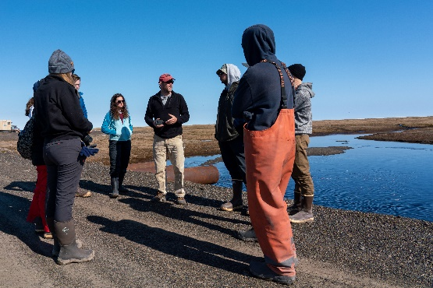
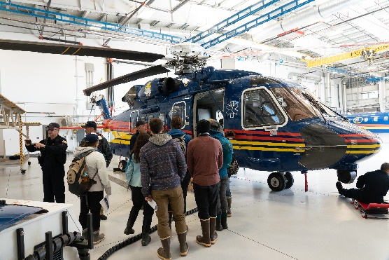
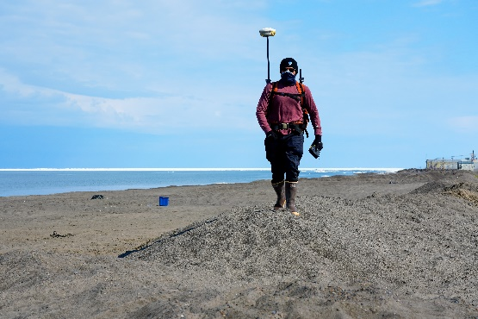
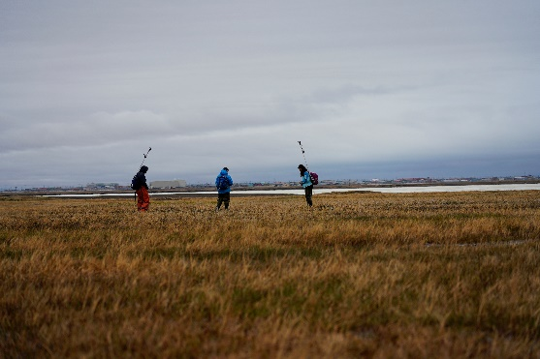
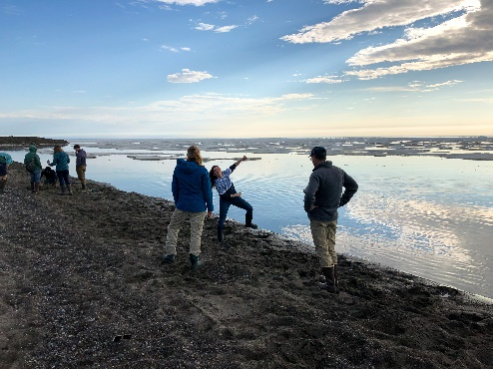
MSI/ASIP 2022 Field Program Overview
ADAC Program Year 8 Annual Meeting
Program Leadership: PI – Dr. Craig Tweedie (UTEP); ADAC Leadership
Dates: June 8 – June 20
Students:
  9 Total Students:
    3 University of Alaska Anchorage Students
    2 U.S. Naval Academy Midshipman
    1 University of Texas El Paso Student
    1 University of New Orleans Student
    1 University of Alaska Fairbanks
    1 University of New Hampshire Student

Slide 24
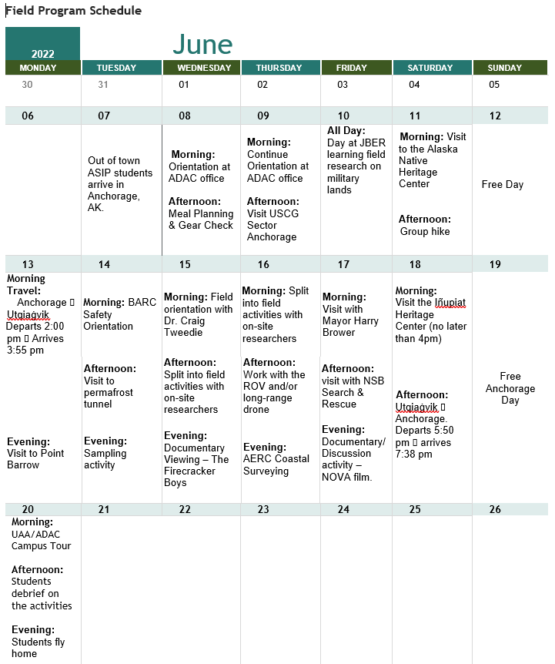
MSI/ASIP 2022 Field Program Schedule
ADAC Program Year 8 Annual Meeting

Slide 25
MSI/ASIP Field Program 2022: Components & Objectives
ADAC Program Year 8 Annual Meeting
Program Components
Program Objectives
Guest Presentations
Independent Projects and Assignments
ASIP Program
Field Research Experience
To prepare students to enter the academic research field from an ADAC fellow perspective, while providing the students with a foundational understanding of the Arctic domain.
To utilize an interdisciplinary and holistic approach to teach students of the interconnected nature of the Arctic domain.
To introduce students to the Homeland Security Enterprise, the role of the USCG in this Enterprise, as well as in the Arctic more broadly.
To expose students to research fieldwork in the Arctic region.
To teach students about working as a team in a pressurized, and weather dependent environment, while also teaching them of critical field safety techniques.

Slide 26
Overview of the Total Numbers
ADAC Program Year 8 Annual Meeting
Total number of ADAC fellows and interns: 47
Total number of students from under-represented classifications in STEM: 23
Post Graduation Pathways:
  Number of students who pursued higher education: 19
  Number of students who pursued work with the Federal Government: 14
    Federal Agencies Include: TSA, the U.S. Army Corp of Engineers, NASA, U.S. National Laboratories, U.S. Navy, and the U.S. Coast Guard
  Number of students who have gone to teach STEM education: 2
  Number of students working towards completing their degree: 20

Slide 27

In Summary…
ADAC Program Year 8 Annual Meeting
In ADAC’s Program Year 8, 6 students were recruited and onboarded as new student fellows for the 2021/2022 academic year, and 9 students are anticipated to participate in ADAC’s 2022 Arctic Summer Internship.
Career options and interest have been looked at on individual basis, and mentoring by ADAC staff has been tailored to assist graduates to transition to Homeland Security Enterprise and/or related employment.

Slide 28
Thank you.
Ready for questions…
ADAC Program Year 8 Annual Meeting
Feedback?
What are we missing?
What can we improve?
Who should we connect with to improve our success?
Notes:
Thank you for the gift of your time and attention.

